Slide 1
Recession Predictor Final Presentation
CS655-151HY - Machine Learning
Group member: Gordon Oboh, Joanne Chen
Professor: Eugene Adjei Djan

Slide 2
Context and Background
Recessions Impacts:
Policy makers
Investors
Businesses
Individuals
Prediction:
10-year minus 2-year Treasury rates (Term Spread)
10-year minus 3-month Treasury Yield Spread
In this project:
Machine Learning & Macroeconomic Datasets
Class Imbalance
Comparative Evaluation Across Models

Slide 3
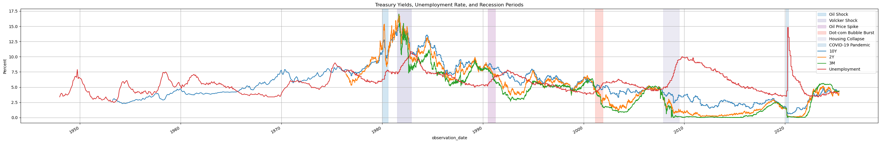
Datasets
10-year Treasury Yield​ - GS10
2-year Treasury Yield​ - DGS2
3-month Treasury Bill Rate – DGS3MO

Slide 4
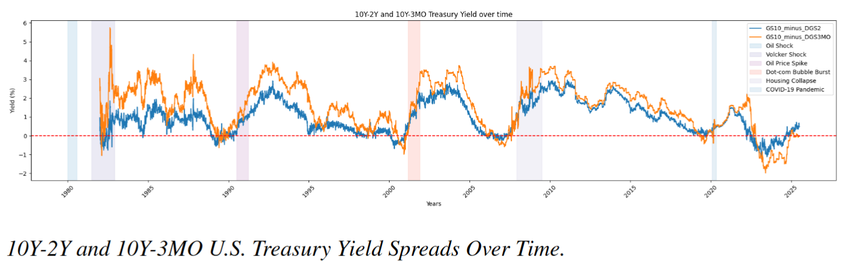
Features
GS10 - DGS2
GS10 - DGS3MO
Recession

Slide 5
Datasets
10-year Treasury Yield​ - GS10
2-year Treasury Yield​ - DGS2
3-month Treasury Bill Rate – DGS3MO
Features
GS10 - DGS2
GS10 - DGS3MO
Recession

Slide 6
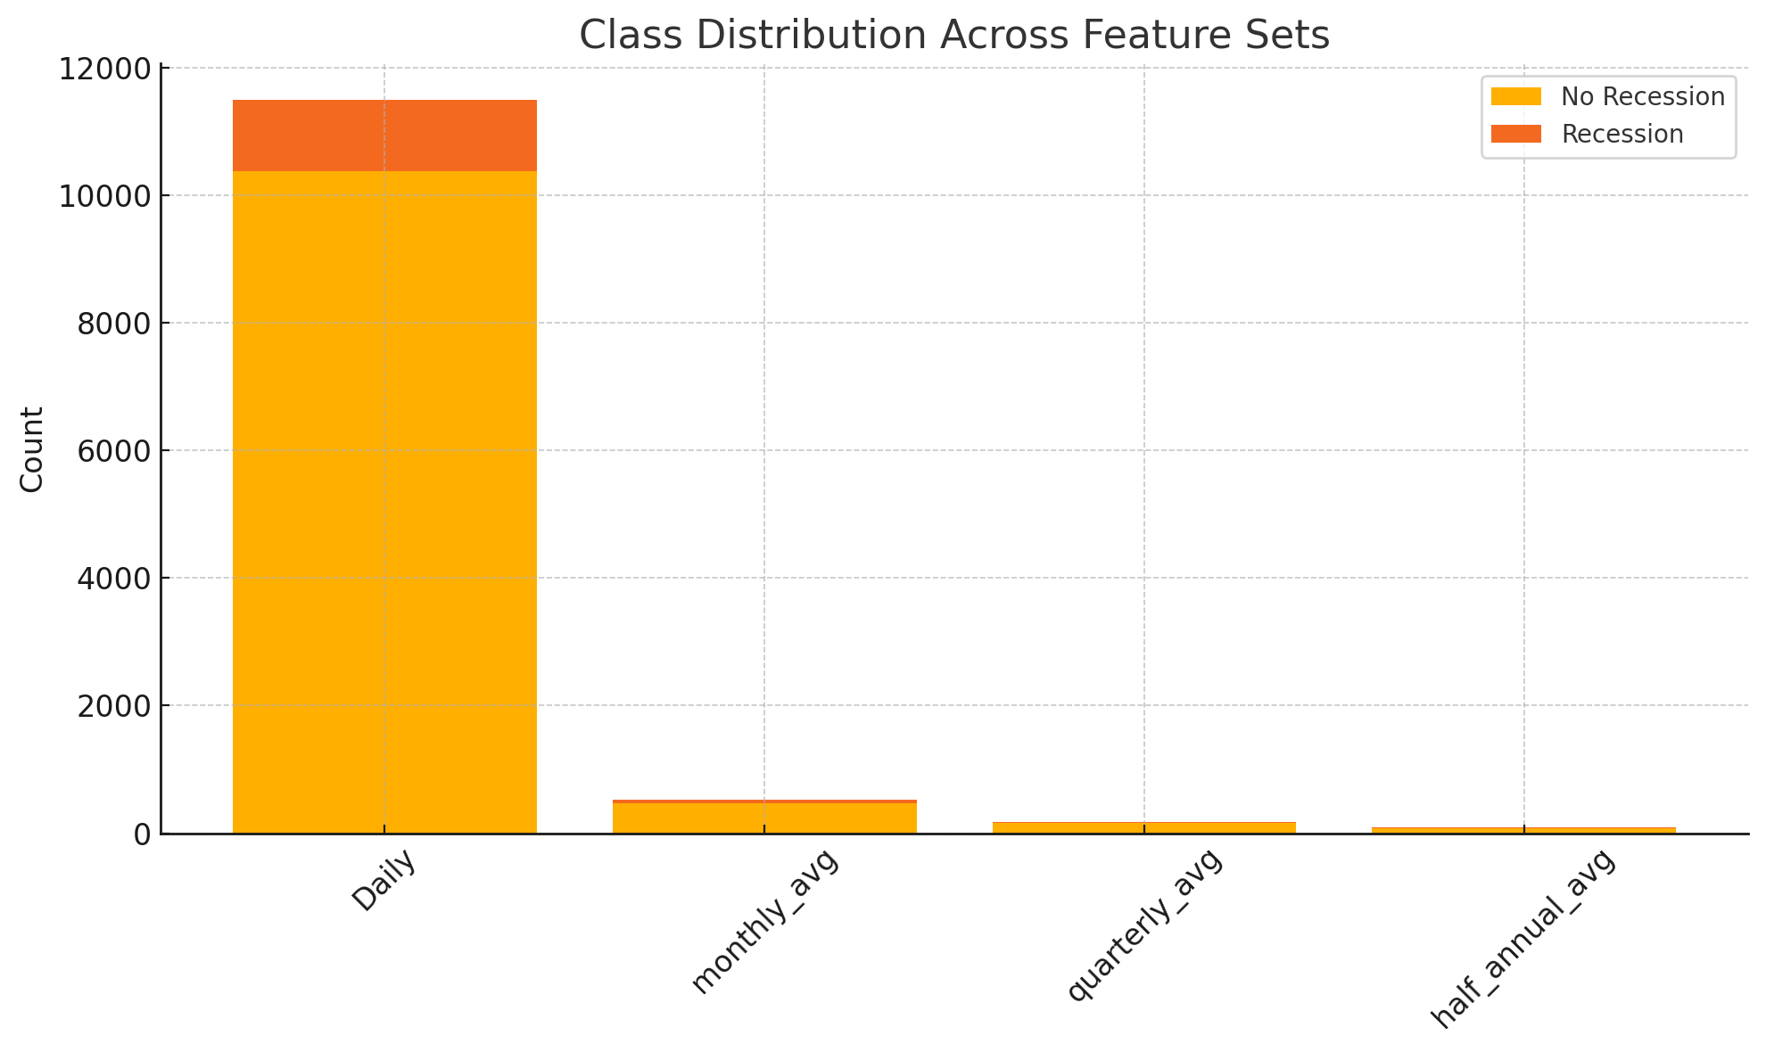
Understanding our Features

Slide 7
Model Selection
Logistic Regression
Easy Ensemble
LSTM (Long Short-Term Memory)

Slide 8
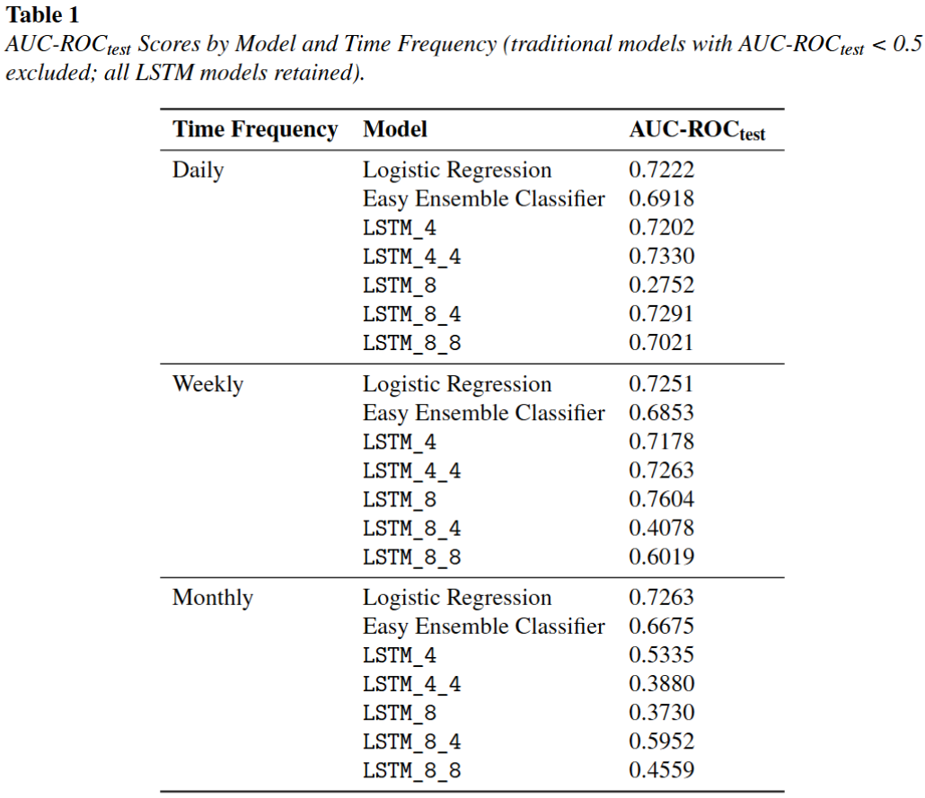
Model Evaluation

Slide 9
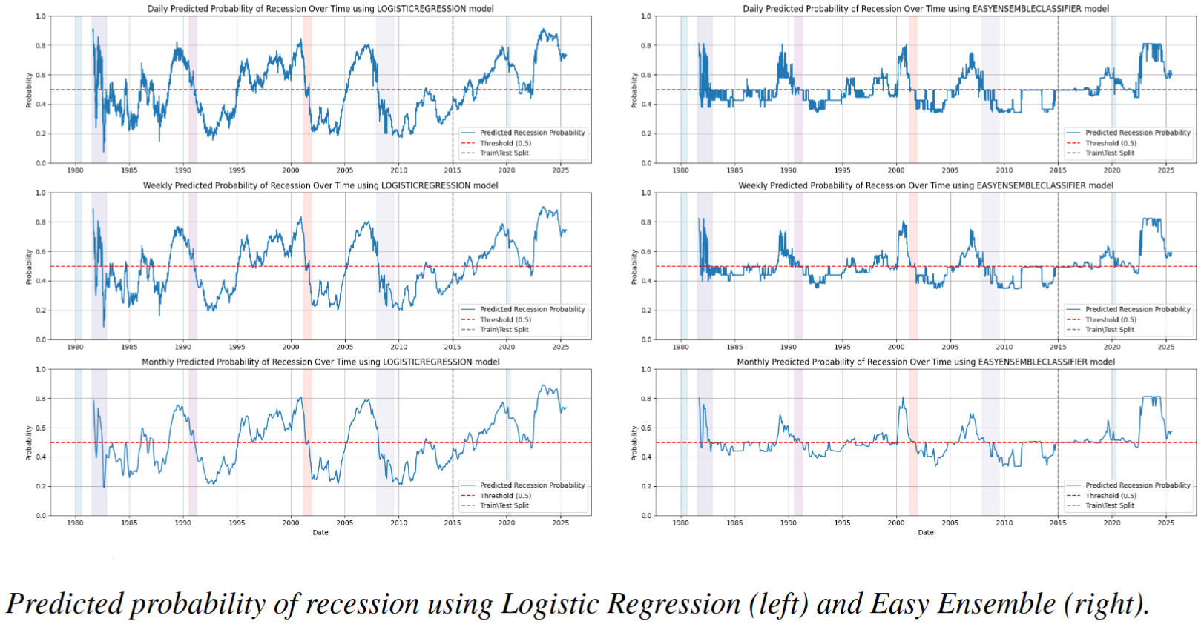
Probability Plot

Slide 10
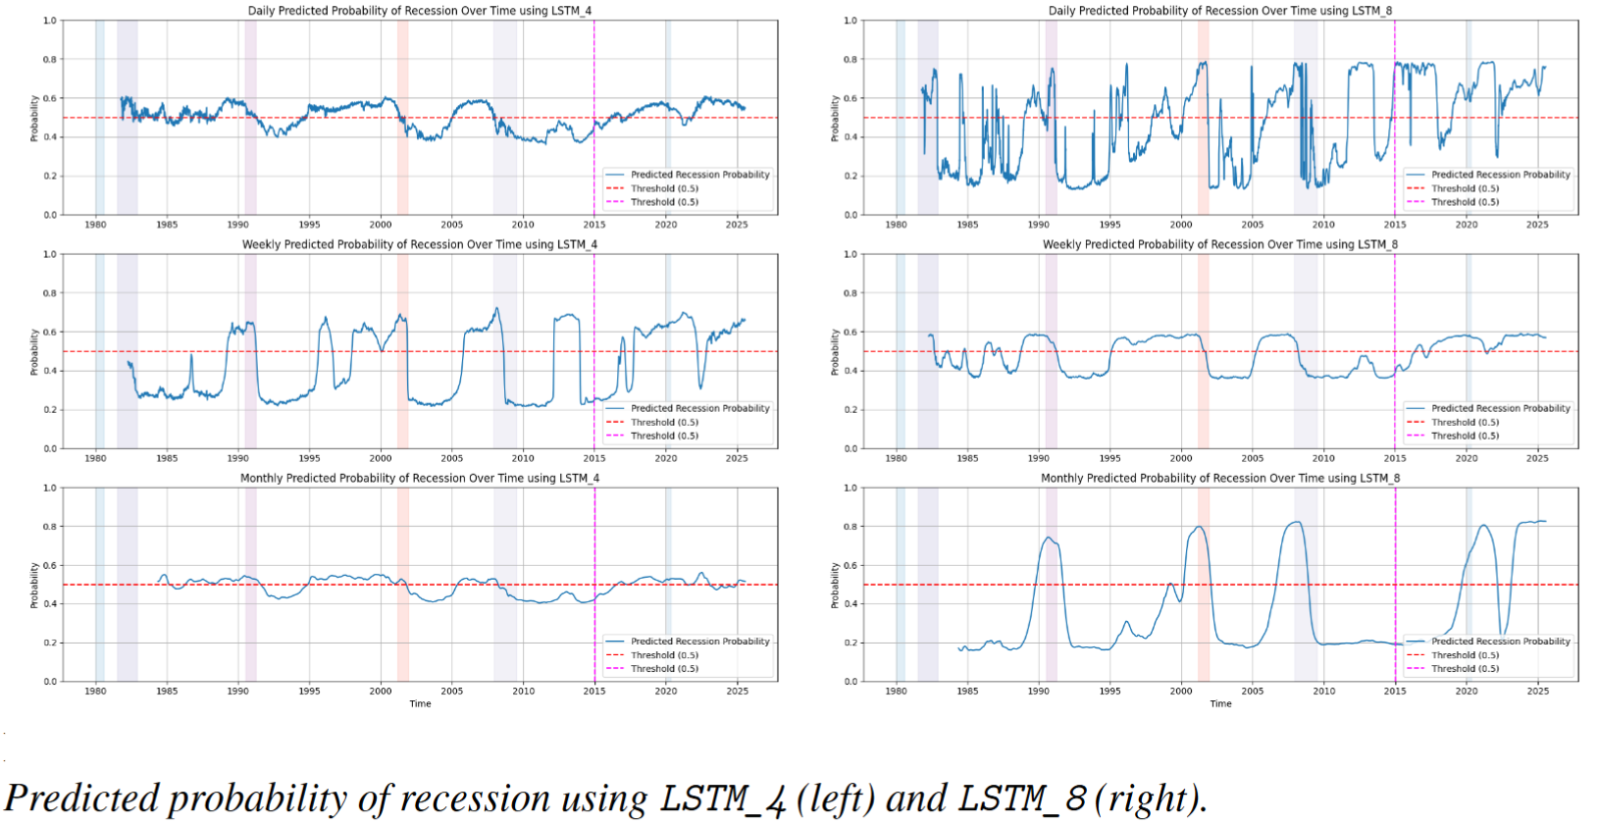
Probability Plot

Slide 11
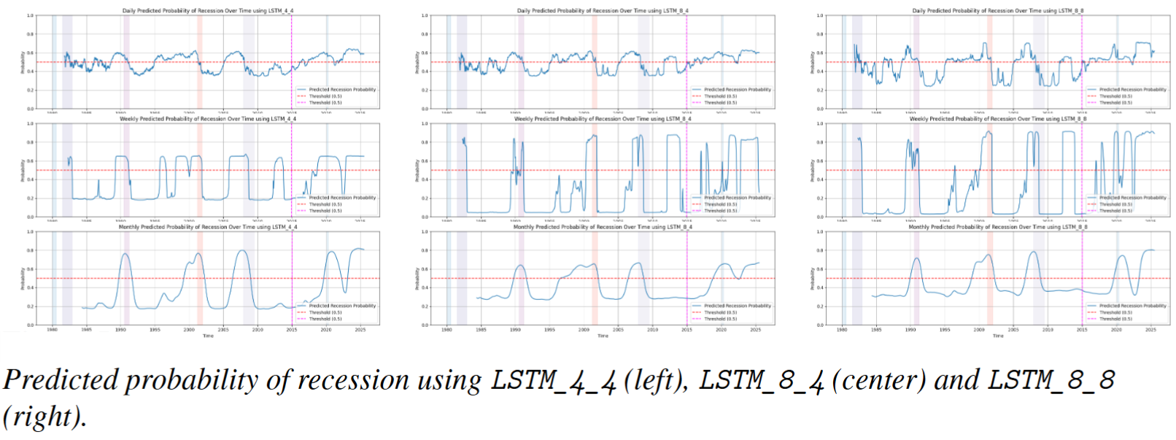
Probability Plot

Slide 12
Results & Conclusion
Logistic Regression
AUC-ROC Score → 0.72-0.726 on all time frequencies
Easy Ensemble
AUC-ROC Score → 0.66-0.69 on all time frequencies
LSTMs
Reasonable Probability Plot for some time frequencies
Not so good AUC-ROC Score
Future Work
Better Metric for Evaluation
LSTM Configuration
BiLSTM Configuration

Slide 13
Thank You! Any Questions?

